Slide 1
Azure Governance: Taming the Beast
Who would have thought that saying “No” could be this much fun?

Slide 2

Scott Corio
Enterprise Cloud Architect, Microsoft MVP – Azure (Cloud Native/PowerShell)
scottcorio
DumpsterDave
https://blog.shitstormbrewing.beer

Slide 3
Housekeeping
Can’t Hear me? Can’t see the slides/content? Please let me know
Clarifying questions during the presentation are welcome
There will be a 10-15 minute Q&A for detailed/use-case-specific questions at the end.

Slide 4
Azure Governance
What is Azure Governance?
Why do we need governance?
How do we implement?
Who should be in charge of it?
When should we do it?

Slide 5
What is Azure Governance?
Governance is Guardrails and Controls
Cost Control
Know what you spend, where you spend it, and what you spend it on
Security
Keeps assets secure and limits access to specific audiences
Reliability
Ensures consistency from asset to asset, subscription to subscription, region to region
Visibility
Know what you have, where it is, and how many there are
Structure
Keep things organized

Slide 6
A quick bit about Structure

Slide 7
AZURE IS NOT YOUR DATACENTER!
While Azure can certainly perform the same function as your datacenter, it is not your datacenter!
While Azure can be structured similarly to a datacenter, it is not your datacenter!
While you can store data in Azure like you do your datacenter, it is not your datacenter.
Azure is NOT your datacenter.
So don’t govern it like one. It requires a different approach.

Slide 8




What Are We Trying To Govern?
Management Groups
These need to be carefully planned and thoughtfully used
Subscriptions
Don’t like to share with other subscriptions
Resource Groups
Group resources by application and lifecycle
Resources
The stuff that actually does stuff

Slide 9
Management Groups
Management groups are ways of structuring/grouping your azure infrastructure to target policies and permissions to a set of subscriptions or other management groups and the assets contained within. Like an OU in Active Directory
The tenant root group always exists and can not be renamed or changed.
You should avoid targeting policies or RBAC assignments to the tenant root group
You should avoid placing subscriptions in the root management group
Management Groups can be nested within other management groups

Slide 10
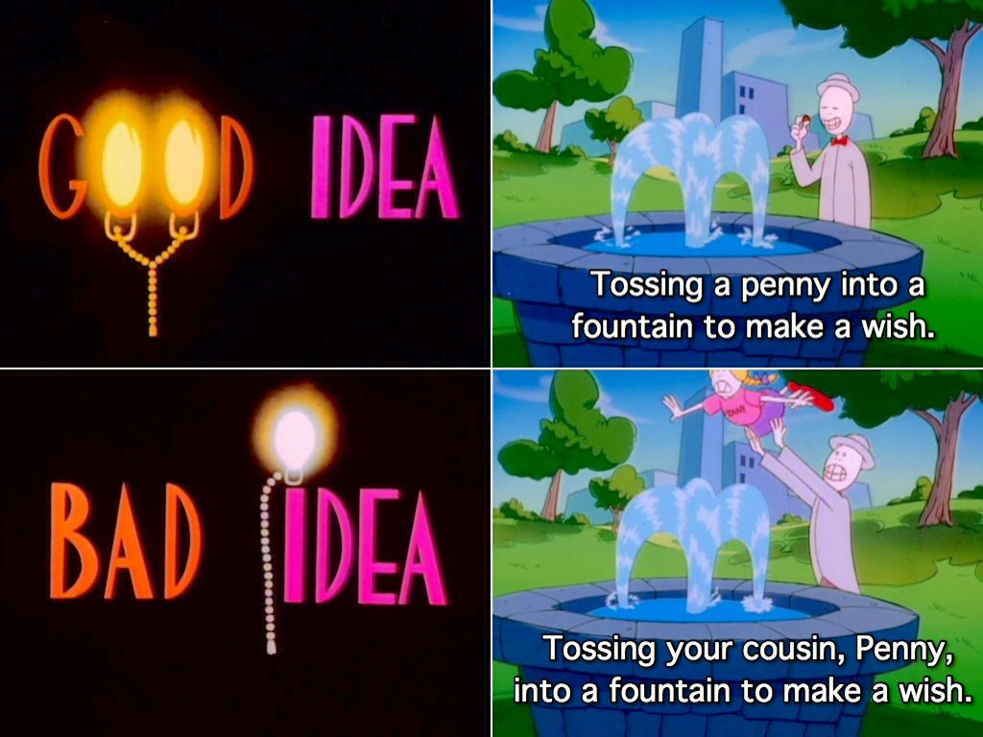
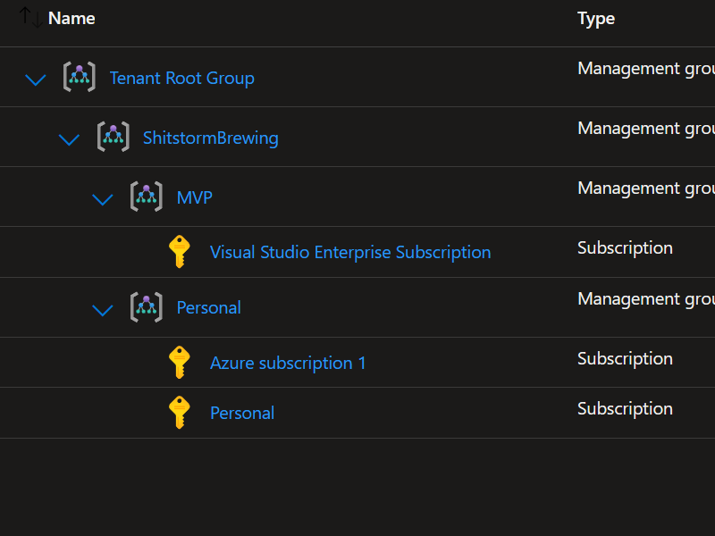
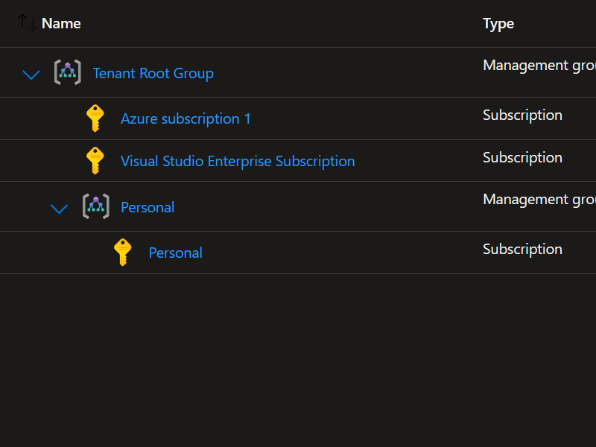
Management Group Structure
Create a new root group
Using the ‘Tenant Root Group’ as your root group

Slide 11
Subscriptions
Subscriptions are the outer boundary for many resources
For the most part, a resource in Subscription A, does not see or talk to resources in Subscription B
Subscriptions need to be planned to work with how your company structures it’s ownership of resources and fiscal responsibility
Azure Offers and SLAs are tied to subscriptions
Dev/Test Pricing
Subscriptions are the boundary for quotas
10,000 VM limit per subscription
2500 RBAC assignment limit
VM CPU Quotas
Some limits are “artificial” and can be increased with a support ticket
Some limits are hard limits and cannot be removed/increased
Subscriptions cannot be nested

Slide 12
Resource Groups
Resource Groups are like folders
Can be used as a cost center, access boundary, or resource containment
They should contain solution specific resources that share a life cycle and are part of the same solution/application (some expections)
Resource Groups cannot be nested

Slide 13
Another Good Idea/Bad Idea
Good Layout
Bad Layout

Slide 14





Managing the Mess
Azure Policy
Enforcing settings and limitations at scale
Cost Management
Knowing what you spend, and setting limits and alerts
Role Based Access Control
Controlling who can play with your toys and in which sandbox
Templates/Blueprints/Deployment Stacks/IaC
Ensures consistency and repeatability
Reporting/Resource Explorer
Knowing what you spend your money on and where it is

Slide 15
Azure Policy

Slide 16
Azure Policy
Azure Policies are like Group Policy SETTINGS. Each policy typically controls one thing, and one thing only.
Policies can make use of parameters to implement the same policy in multiple locations (scopes) with different effects.
Multiple Policies can be grouped together in an “Initiative” to be assigned together in a consistent manner.
Policies can be deployed in different modes which each have different outcomes. This allows the same policy to do different things depending on how it’s deployed.
Policies can have exceptions (similar to block inheritance on GPOs)
Policies can have criteria which targets to specific resources within a broader scope.

Slide 17
Policy Structure
displayName: The name that appears in the Azure portal. Use a naming convention here!
parameters: Optional field that lists the parameters, their type, and any additional information or constraints.
{
"properties": {
"displayName": "Allowed locations",
"description": "This policy enables you to restrict the locations your organization can specify when deploying resources.",
"mode": "Indexed",
"metadata": {
"version": "1.0.0",
"category": "Locations"
},
"parameters": {
"allowedLocations": {
"type": "array",
"metadata": {
"description": "The list of locations that can be specified when deploying resources",
"strongType": "location",
"displayName": "Allowed locations"
},
"defaultValue": [ "westus2" ]
}
},
"policyRule": {
"if": {
"not": {
"field": "location",
"in": "[parameters('allowedLocations')]"
}
},
"then": {
"effect": "deny"
}
}
}
}
description: Describe what the policy does! Your future self will kill you if you don’t
if:
The criteria which the policy will be evaluated against
mode: all – evaluate resource groups, subscriptions and all resource types
indexed – only evaluate resources that support tags and location
effect: What to do if the criteria is met

Slide 18
Policy Effects Explained
AddToNetworkGroup
Used for VMs to define dynamic network group membership. (Microsoft.Network.Data policy mode definitions only)
Append
Add more fields to the requested resource (Such as allowed IPs on a storage account)
Audit
Creates a warning event in the activity log when non-compliance is detected
AuditIfNotExists
Evaluates after the creation of a resource and creates an audit event if the resource fails at that point. Some resources can’t pass audit before they are created, use this in those cases.
Deny
Prevents a request that doesn’t satisfy the policy criteria
DenyAction
Prevents a request based on the intended action (DELETE is the only one supported currently)

Slide 19
More Policy Effects Explained
DeployIfNotExists
Deploys additional resources if they don’t exist to bring a resource into compliance. Does not run on the evaluation cycle, but can be triggered in the remediation steps.
Disabled
For testing or when the policy has a parameterized effect. Can be used to disable a single assignment instead of modifying all assignments.
Manual
Allows you to manually mark resources as compliant. Can be used as a “ToDo list”
Modify
Allows you to add, replace, or remove resource tags during creation or update
Mutate
Turns your resource into Wolverine or Deadpool
Just kidding, it’s for Kubernetes.

Slide 20
Policy Resources
Details of the policy definition structure - Azure Policy | Microsoft Learn

Slide 21
That’s Against Company Policy!
A demonstration of implementing, customizing, and utilizing Azure Policy

Slide 22
Cost Management
Nobody loses their job for saving money… usually.

Slide 23
Cloud pricing journey
Different pricing actions correspond to different milestones in your cloud journey.
Consider Azure
Assess and plan
Deploy
Manage and optimize
Set up the platform for success.
Understand value and build confidence.
Prepare for moving forward with project and build a plan.
Establish management and optimization excellence.
Pricing needs through the journey
Understand how Azure pricing works
Estimate project costs on Azure
Budget for specific Azure services
Optimize spend for Azure workloads

Slide 24


Calculate costs of Azure products/services
Strategic pricing offers
Azure Hybrid Benefit
Save up to 85% over the standard pay as you go rate when leveraging WS and SQL Server licenses with AHB¹.
By applying existing Windows Server or SQL Server licenses to Azure Hybrid Benefit you can achieve cost savings while optimizing your hybrid environment
Use Azure services and on-prem licenses simultaneously to modernize and manage while migrating to the cloud
Leverage your BYOS Suse and RedHat Linux rights to avoid redeployment or reboot downtime when enabling AHB²
Azure reservations
Save up to 72% compared to pay-as-you-go prices with Azure Reserved VM Instance³
Lower your total cost of ownership by combining Azure Reserved VM Instances rates with a pay-as-you-go subscription to manage costs across predictable and variable workloads.
Utilize for stable, predictable workloads with no planned changes.
Azure savings plan for compute
Save up to 65% compared to pay-as-you-go prices on select compute services⁴
Save money across select compute services globally by committing to spend a fixed hourly amount for 1 or 3 years, unlocking lower prices until you reach your hourly commitment.
Utilize for dynamic workloads while accommodating for planned or unplanned changes
¹ Azure Hybrid Benefit - Hybrid Cost Calculator | Microsoft Azure
² Microsoft has conveniently negotiated this rights alongside the AHB right to migrate to Azure
³ Azure Reserved Virtual Machine Instances | Microsoft Azure
⁴ Azure savings plan for compute

Slide 25
Plan for known usage needs and realize instant savings
$1,900,000 total
$900,000
Windows Server cost
Optimizing compute costs at scale | example
Your compute cost totals $1,000,000 billed on a pay-as-you-go basis.
Your Windows Server cost totals $900,000 billed.
By allocating spend to the appropriate savings options based on usage needs, you can take your budget further.
$550,000 total ($1,350,000 savings)
$200,000
Unpredictable compute usage
$0
Windows Server applied to AHB*
Purchase reserved instances for your most stable resource needs.
Optimizes $300,000 costs to $150,000
Purchase an Azure savings plan for compute to cover your dynamic resource needs.
Optimizes $500,000 costs to $200,000
Apply your existing Windows Server licenses to AHB to cover your Windows Server cost.
Reduces $900,000 costs to $0
Continue paying only for what you use for your most inconsistent resource needs.
No commitment required.
$500,000
Dynamic resources with steady spend
$200,000
Pay-as-you-go
$200,000
Azure savings plan for compute
$300,000
Stable compute resources
$150,000
Reserved instance
Your optimized compute cost totals $550,000 with savings options.
With $1,350,000 savings, you may fund additional new projects on your IT transformation journey.
Without savings options
(pay-as-you-go pricing)
With savings options
Example presented for illustrated purposes only, not actual pricing and spend
*SA Cost still incurred

Slide 26



Manage and optimize Azure investments
Cost-effective tools and practices
Azure Advisor
Digital cloud assistant that helps customers follow best practices to optimize their Azure deployments.
Analyzes resource configuration and usage telemetry
Recommends solutions to help customers improve the cost effectiveness, performance, reliability, and security of their Azure resources
Provides best practice recommendations to help customers optimize Azure workloads
FinOps on Azure
Operational framework and cultural practice that brings together technology, processes, and people to maximize the value of cloud investment:
Enforce consistent resource configurations
Enforce policies for accountability and efficiency
Automate operations
Continuously optimize resource utilization based on workload demands
Microsoft Cost Management
Microsoft Cost Management allows customers to reduce costs while boosting the efficiency of their cloud investments.
Continuous monitoring and reporting
Understand costs through visualization
Implement financial governance
Resource:
Azure Advisor
Resource:
Azure FinOps
Resource:
Microsoft Cost Management

Slide 27
Cost Management
Pinching pennies in the digital age

Slide 28
RBAC

Slide 29
Why Do We Need RBAC?
We can’t all run around as Global Admin all the time
Allows you to group permissions based on ‘roles’
Can be applied at various levels
Tenant (Entra ID Roles)
Management Group
Subscription
Resource Group
Resource
Item
Gives non-azure people ‘just enough’ power to break their own stuff, but not yours!

Slide 30
Roles
Roles fall into two types
BuiltIn
Custom
Are scoped based on the highest level they can be applied
Comprised of Actions, NotActions, DataActions, and NotDataActions
Can have Conditions (Currently, Storage Blobs and Queues only)

Slide 31
Role Definition Structure
{
"id": "/subscriptions/d20951bd-fd1a-4e7a-a36c-965b2caa6c60/providers/Microsoft.Authorization/roleDefinitions/90399520-0aff-42c3-b88f-7f289cdbfad9",
"properties": {
"roleName": "Application Owner",
"description": "Application Owner Or Development Team to have READER only access on APP RGs in addition to Start Stop and Restart VMs",
"assignableScopes": [
"/subscriptions/d20951bd-fd1a-4e7a-a36c-965b2caa6c60"
],
"permissions": [
{
"actions": [
"Microsoft.Authorization/*/read",
"*/read",
"Microsoft.Compute/virtualMachines/start/action",
"Microsoft.Compute/virtualMachines/restart/action",
"Microsoft.Compute/virtualMachines/deallocate/action"
],
"notActions": [
"Microsoft.Authorization/diagnosticSettings/read",
],
"dataActions": [
"Microsoft.Storage/storageAccounts/blobServices/containers/blobs/*"
],
"notDataActions": [
"Microsoft.Storage/storageAccounts/blobServices/containers/blobs/modifyPermissions/action"
]
}
]
}
}

Slide 32

Recomended Structure
Entra Tenant
Assignment Group
Enterprise Apps/Managed Identities
Role Group
Users

Slide 33
Use Naming Conventions
Assignment groups should contain information that allows a non-familiar person to easily identify where it should be applied and what it should do
Examples:
MG-PLATFORM-READER
SB-AMER-OWNER
RG-SAP-BACKUP_OPERATOR
RS-SAPSTA01-STORAGE_BLOB_DATA_CONTRIBUTOR
Role Groups should be broken down as needed, and be unique
If the same 3 users are in 4 different groups, do you really need 4 groups?
Examples:
MSP-HELPDESK
MSP-L2_SUPPORT
CONTOSO-AZURE_ADMINS
CONTOSO-WEB_DEVELOPERS

Slide 34
RBAC
Because I haven’t figured out how to demo RFRONT
Notes:
New resource graph table returning RBAC roles
Announcing AuthorizationResources in Azure Resource Graph (microsoft.com)

Slide 35
Templates/Deployment Stacks/IaC
Deploying stuff at scale

Slide 36
Why not deploy via the Portal
The portal doesn’t present every single option to us
We can only deploy one thing at a time (and sometimes the dependencies)
Less control over some aspects (especially with dependencies)
More opportunities for mis-steps

Slide 37
So Many Options!
ARM Templates
The core/most basic level of a resource
Template Reference
Template Structure
JSON Format
Supports Linking, Dependencies, and Loops
Azure Only
Terraform
A 3rd Party Automation Tool
Most flexible, most complex
Cross Platform
Deploys assets as either a CLI command or ARM template
Bicep
Newer, simpler version of ARM Templates
At runtime, builds and then deploys an ARM template
Bicep Structure
Azure Only

Slide 38
Templates
Templates allow us to deploy one or more resources in a single “deployment”
Parameters reduce what needs to be changed
Can be provided via the CLI or a parameter file
Can make parameters mandatory or optional and set default values.
Variables can be used to hold information and extend parameter capabilities
User Functions
Take Input, do something, and then provide a single output
Resources
One or more resources that get deployed. Can be dependent on other resources in the template

Slide 39
Deployment Stacks
Deployment Stacks represent what a set of resources should look like
Allow managing a set of resources as an atomic unit
Are not incremental like Templates
Resources that get removed from the deployment stack are either detached or deleted depending on how the stack is defined
Allow the use of deny settings to block un-intentional modification (similar to locks)
Can be created at the resource group, subscription, or management group level.

Slide 40
Infrastructure as Code
There is no Production Portal!
We can use a tool such as Azure DevOps to easily deploy new assets and keep an inventory of the assets that we’ve already deployed
Allows us to grant users access to the tools, but not the environment
DevOps uses Service Connections that have high level permissions
Pipelines allow us to implement “approvals” or “stage gates” before anything gets deployed
Can expand the deployment beyond just the resources in azure, but also extend to the contents
Example, deploy a web app, container registry, build a docker image, and push it to the container registry.
Provides an easy audit trail

Slide 41
How we Deploy Stuff
Because clicking through the portal doesn’t give us all the options

Slide 42
Q&A

Slide 43





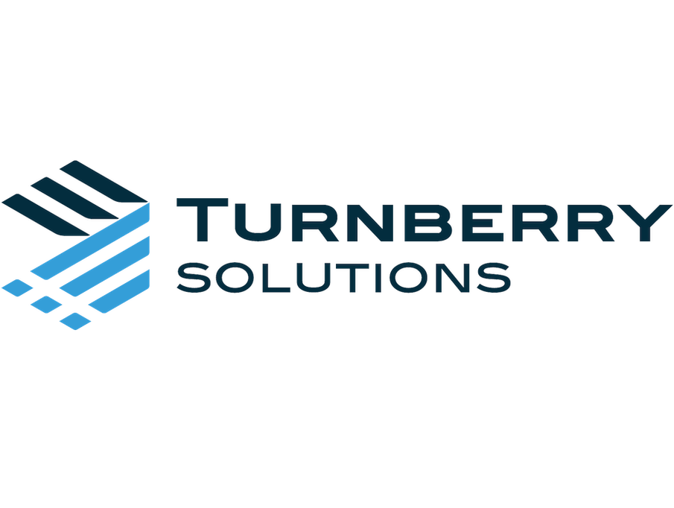

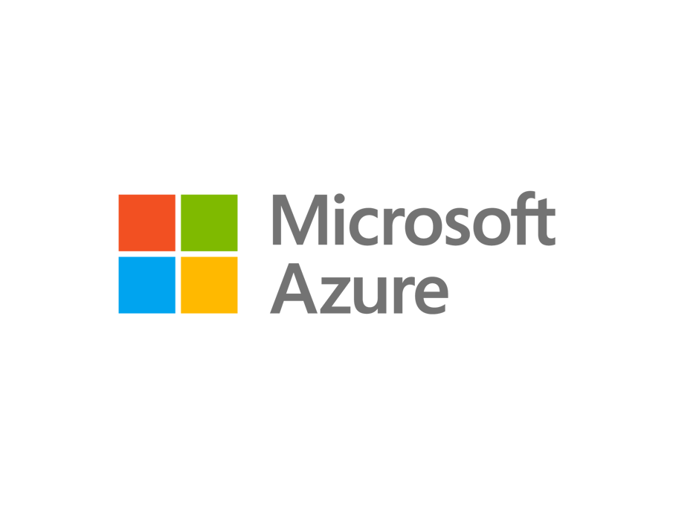
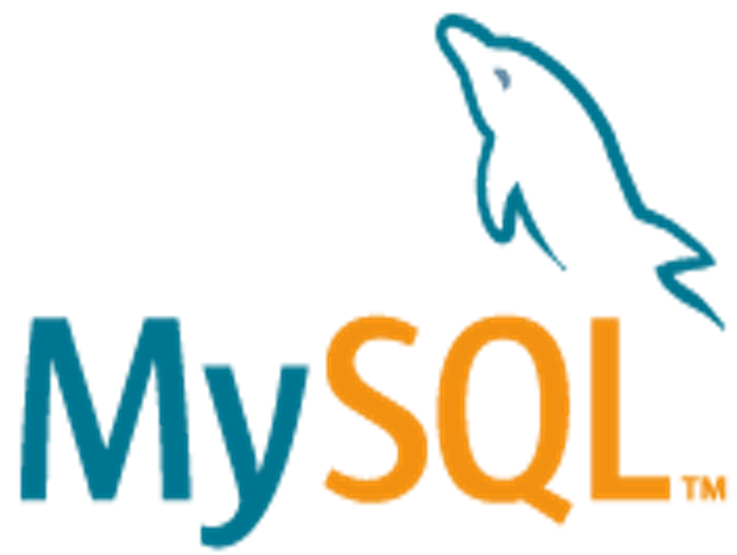


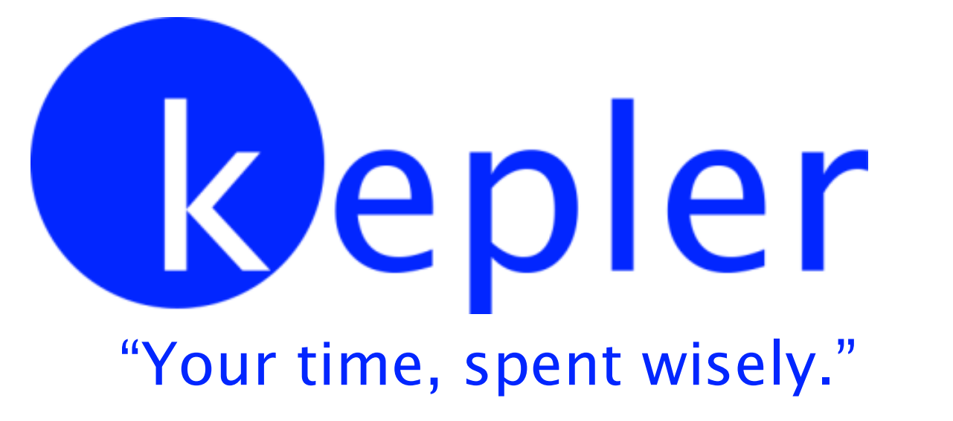

Thank you to our Sponsors!

